Slide 1
Agile Software Development
The Waterfall Methodology (i.e. not agile)
Agile Methodology
One popular agile framework: Scrum
The actors
Sprint overview:
The sprint planning meeting
The scrum board
The daily scrum meeting
The demo
The sprint retrospective
<repeat>
Ryan Henning
Notes:
Suggested reading:
https://www.infoq.com/minibooks/scrum-xp-from-the-trenches-2

Slide 2
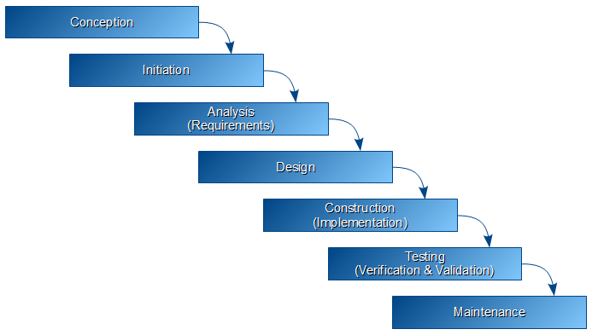
What’s a good development methodology for manufacturing/construction projects?
The Waterfall Methodology:
Notes:
https://en.wikipedia.org/wiki/Waterfall_model
The waterfall methodology works great for manufacturing and construction where you are dealing with physical products. In these industries, you can’t go backwards (or it is at least very expensive to do so). Also, in these industries, the tangible nature of the product (in comparison to the intangible nature of software) makes requirements easier to write and makes the process of planning into the future more feasible.
But, software is different. It is highly complex, the internal components are often very intertwined by nature compared to the interplay between physical components (e.g. between the door of your house and the windows of your house), the variety of input it receives is vast compared to a physical object (e.g. consider the input to your front door compared to the input to google slides). But, software does have one thing that makes it easier: It is cheap to make changes (you just have to pay the programmer) compared to changing a manufacturing process (where you have to build a new factory).
So… the waterfall methodology doesn’t make sense for software. That doesn’t mean it isn’t used for software development though! It was used a lot in the early days (think 70s, 80s, 90s) because there was no other clear ways to do it, and it is still used in some slow-to-change software teams (think government contractors and banks).
For software, what makes sense. How should we change this picture?
Btw, the waterfall method is still being taught for software development in university. It’s whack. And they argue about the stupidest things, like what the difference between ‘conception’ and ‘initiation’ is, and what the difference between ‘verification’ and ‘validation’ is.

Slide 3
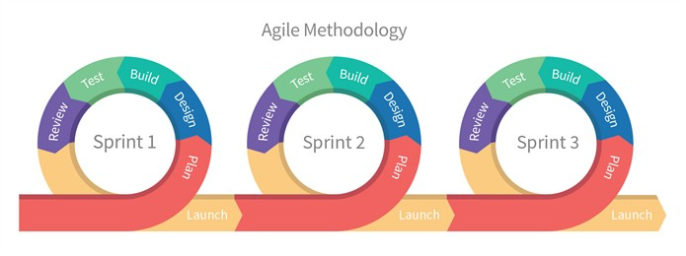
What makes more sense than the waterfall methodology for software development?
Agile Methodology:
Notes:
http://www.agilemanifesto.org/
http://www.screenmedia.co.uk/blog/2014/08/what-is-agile-development-a-brief-introduction/
With software development, being intangible and complex, it’s hard to see the end from the beginning. Or if you think you can see the end, you’re often wrong about what the end should look like.
The idea here is that we are constantly re-evaluating what we’re doing, and we’re letting the customer/CEO/whatever see progress along the way, and we’re gathering feedback along the way that will change our trajectory. This way we don’t have to see the total-end super-clearly, we only need to see the end of the next sprint super-clearly.
Each ‘sprint’ looks like a mini-waterfall (plan, design, implement, review), but a sprint only lasts a few weeks! Usually each sprint is 2 to 6 weeks (but is consistent for a given dev team!).
Btw, we have been calling each morning and afternoon exercise a ‘sprint’, but that’s really an incorrect use of the term. :)

Slide 4
The Agile Manifesto www.agilemanifesto.org
Individuals and interactions over processes and tools
Working software over comprehensive documentation
Customer collaboration over contract negotiation
Responding to change over following a plan
That is, while there is value in the items on
the right, we value the items on the left more.
Notes:
http://www.agilemanifesto.org/

Slide 5
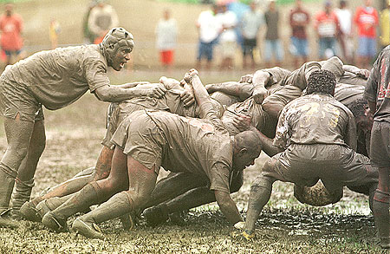
One Popular Agile Framework: Scrum
Not the rugby kind...

Slide 6
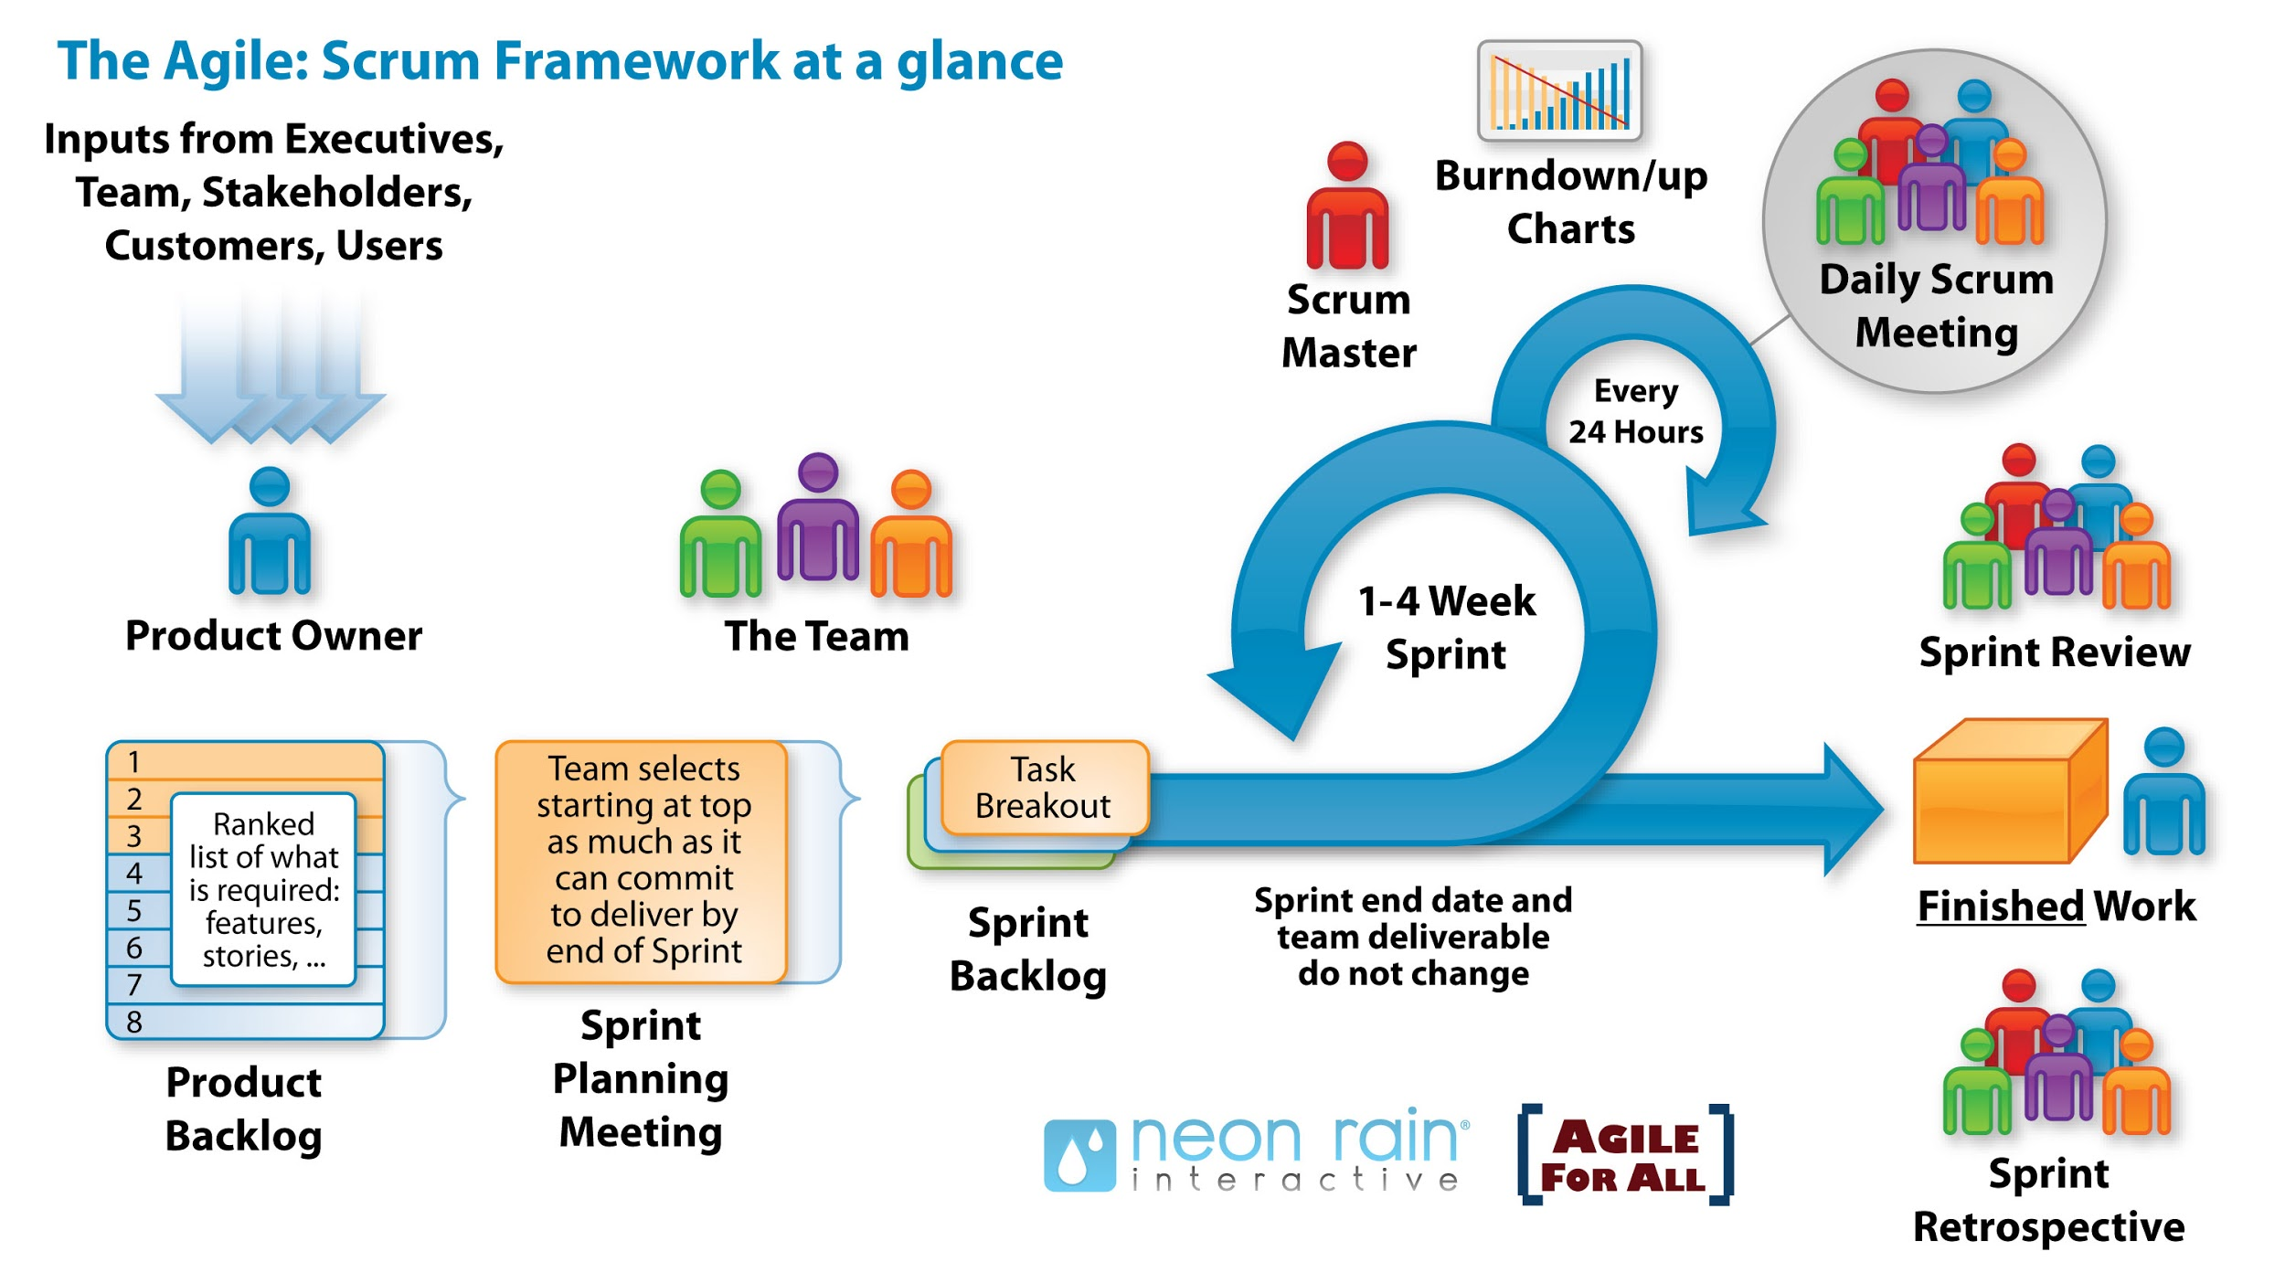
One Popular Agile Framework: Scrum
Notes:
https://www.softwaysolutions.com/blog/wp-content/uploads/2012/10/scrum_process_big3.jpg

Slide 7
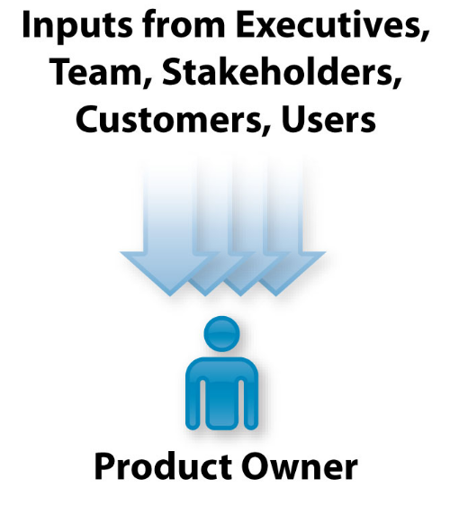


The Actors
Notes:
The product owner is responsible for making the product successful. He reports to the executives, the stakeholders, etc about the successes and failures of the product.
The scrum master is part of the team. What sets the scrum master apart is that he will communicate with the product owner often (daily, sometimes) about how development is going. The scrum master will also ensure that the scrum process is being followed (which we’ll talk about in the coming slides). But, really, the scrum master is a part of the team and will spend much of his time coding, testing, etc.
The team is a collection of software engineers, data scientists, graphic designers, etc. They are the ones (along with the scrum master) who actually build the product.

Slide 8
One Popular Agile Framework: Scrum
Notes:
https://www.softwaysolutions.com/blog/wp-content/uploads/2012/10/scrum_process_big3.jpg

Slide 9
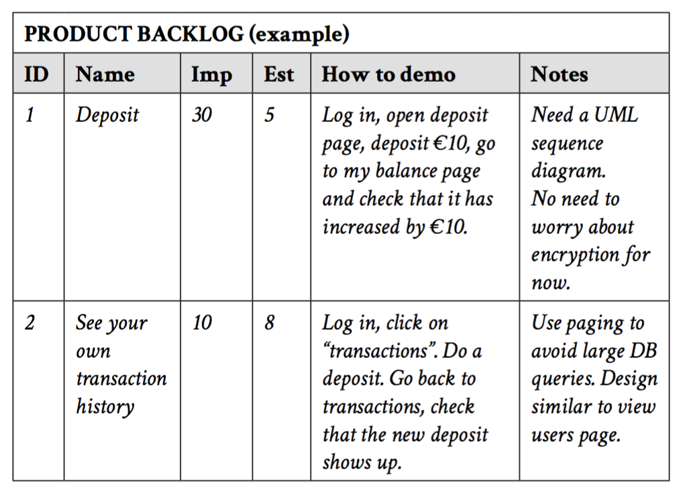
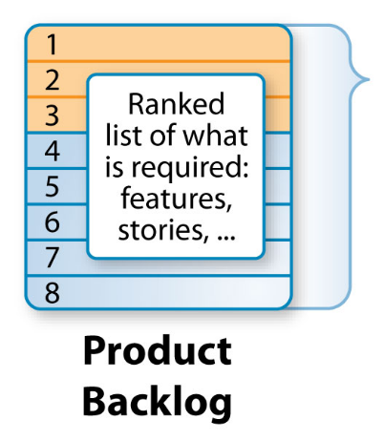
The Product Backlog
Notes:
The product owner owns the product backlog. He adds stuff, names it, knows how it should be demo’d, and he prioritizes them via the importance column (high numbers = more important).
The team writes the initial estimate (‘est’, the initial guess at the number of ‘story points’ required to complete the task/story/feature/item). And the team writes the notes.
Note anyone can add stories, but the product owner is who prioritizes, and the team is who estimates time.
The right image is borrowed from “Scrum and XP from the Trenches”.

Slide 10
One Popular Agile Framework: Scrum
Notes:
https://www.softwaysolutions.com/blog/wp-content/uploads/2012/10/scrum_process_big3.jpg

Slide 11
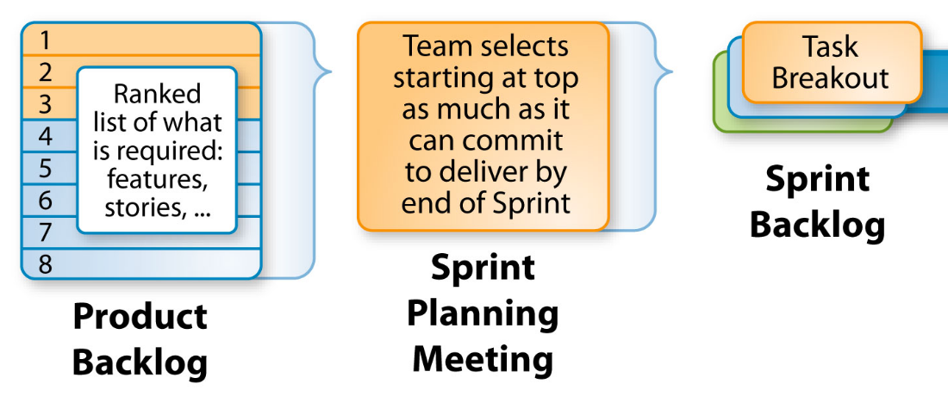
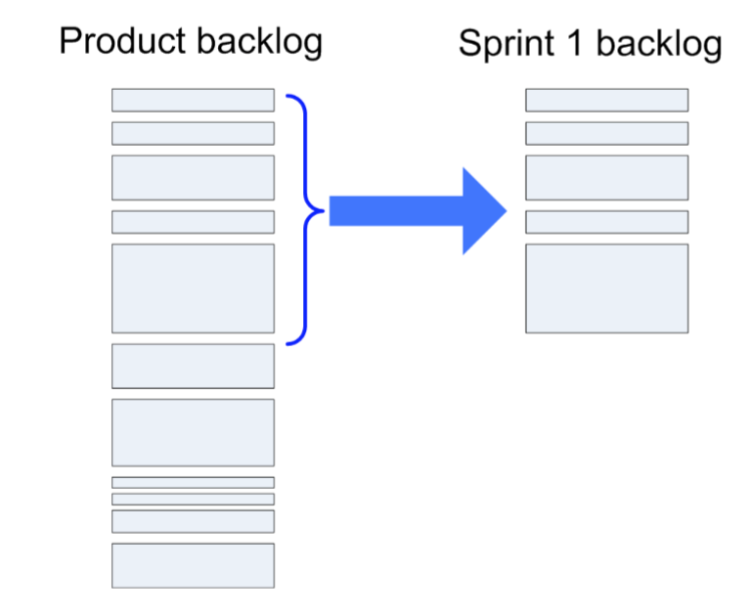
Sprint Planning Meeting → Sprint Backlog
Notes:
Before the sprint begins, you must plan it! You hold a sprint planning meeting. All actors are involved (product owner, team & scrum master).
This is where the team commits to doing the top X stories from the product backlog. They’ll estimate the time required for each story, and take as many as they can in order to fill up their sprint backlog. The sprint backlog become the task list for the upcoming sprint.
The product owner is there because he/she might want to reprioritize after hearing the estimates given by the team. Also to explain to the team why certain things are important. Also, this is the team’s chance to ask for time to do ‘cleanup tasks’, and a good product owner will know when to allow such tasks. Also, the team can ask for clarification about scope.
The right image is borrowed from “Scrum and XP from the Trenches”.

Slide 12
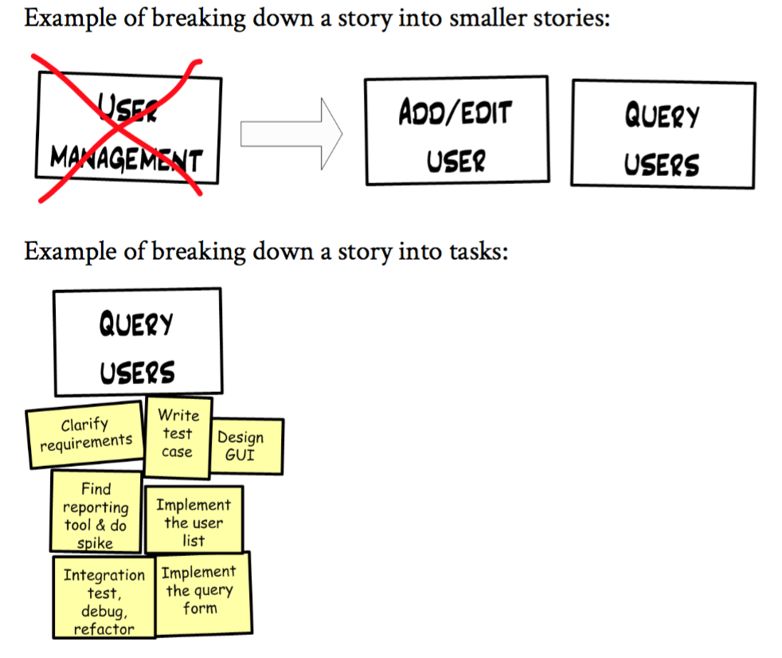
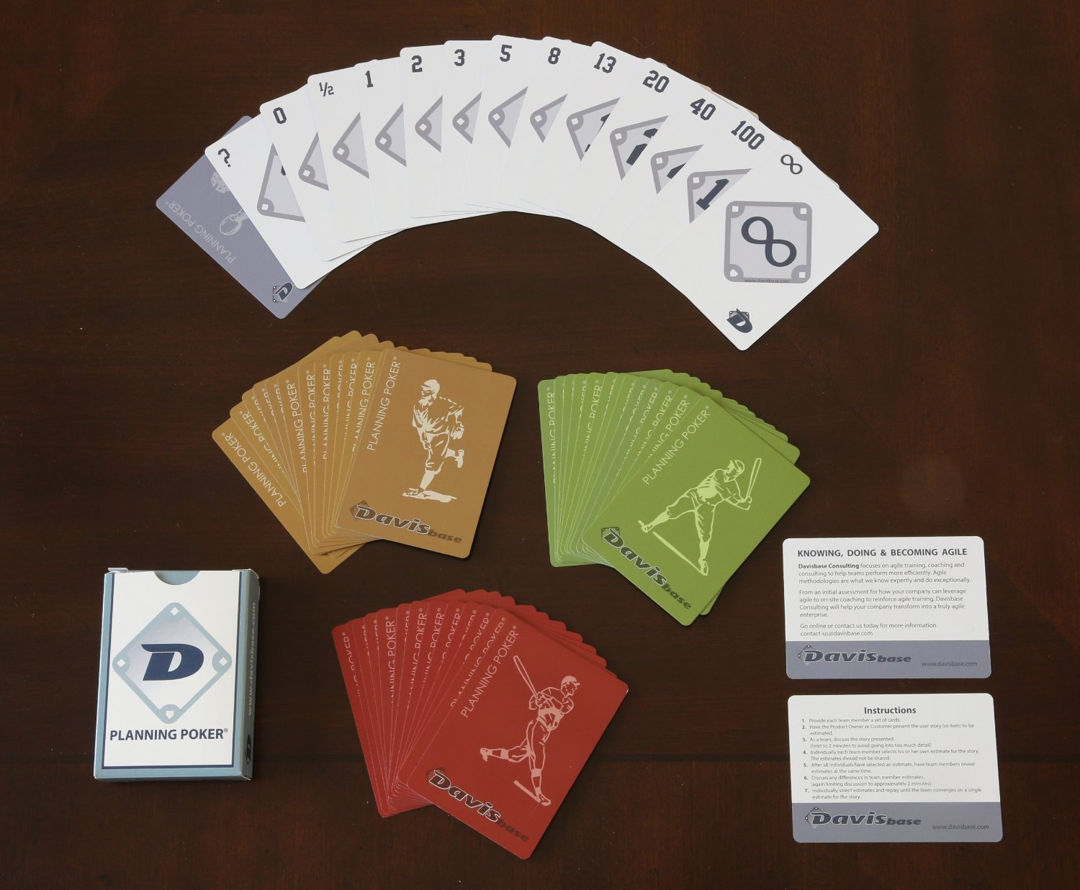
How to estimate ‘story points’ for each story
Notes:
The process of estimating the time required for each item is fascinating. First off, the unit of ‘time’ is in what they call ‘story points’. Story points for sprint 1 will be man-hours. But over time, usually, story points will become something else--the team will sort of self-calibrate on a way of talking about story points.
You also should break stories down if they are too large. And also break stories into tasks to make estimating easier.
The next important point about estimating is that you should play ‘planning poker’!
These images are borrowed from “Scrum and XP from the Trenches”.

Slide 13
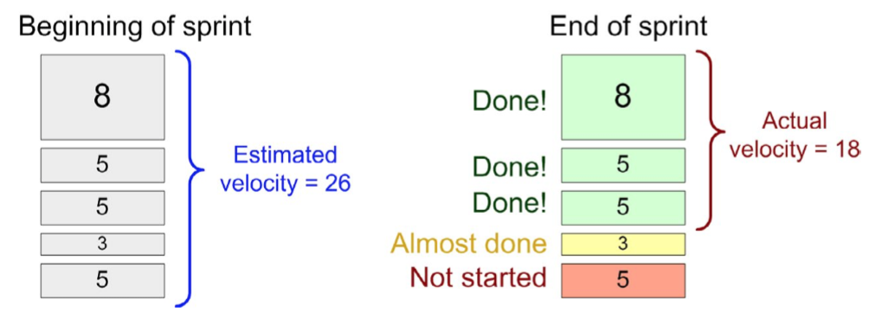
Keeping track of your team’s velocity, sprint-after-sprint
Notes:
How many sprint points can you team handle per sprint? Well, let’s look at how many your team did historically! We call this your team’s ‘velocity’.
These images are borrowed from “Scrum and XP from the Trenches”.

Slide 14
One Popular Agile Framework: Scrum
Notes:
https://www.softwaysolutions.com/blog/wp-content/uploads/2012/10/scrum_process_big3.jpg

Slide 15
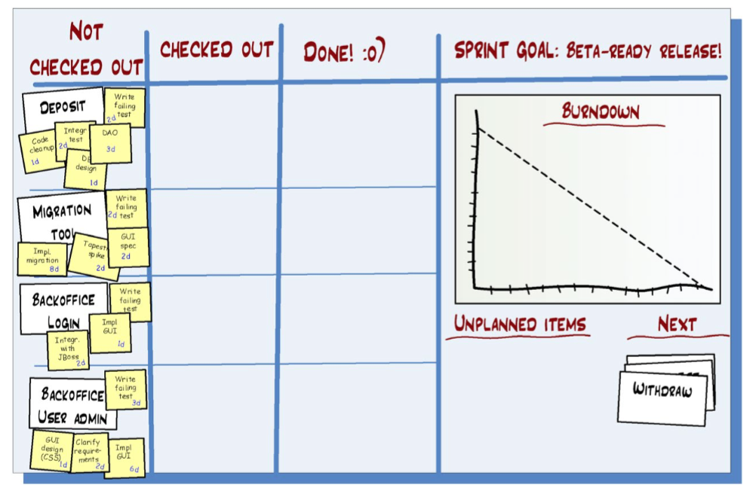
The Sprint Backlog + The Burndown Chart (aka, the Scrum Board)
Notes:
Here is the scrum board. This is at the beginning of the sprint. No work has been done yet. Notice the stories and the tasks are in the ‘not checked out’ column. When work begins, you ‘check out’ a task. When you’re done (i.e. ready to demo it and withstand scrutiny), you move it to done.
Each day you add up the non-done story points and plot it on the burndown chart to see if you are on-track to finish all the tasks for the sprint.
Image borrowed from “Scrum and XP from the Trenches”.

Slide 16
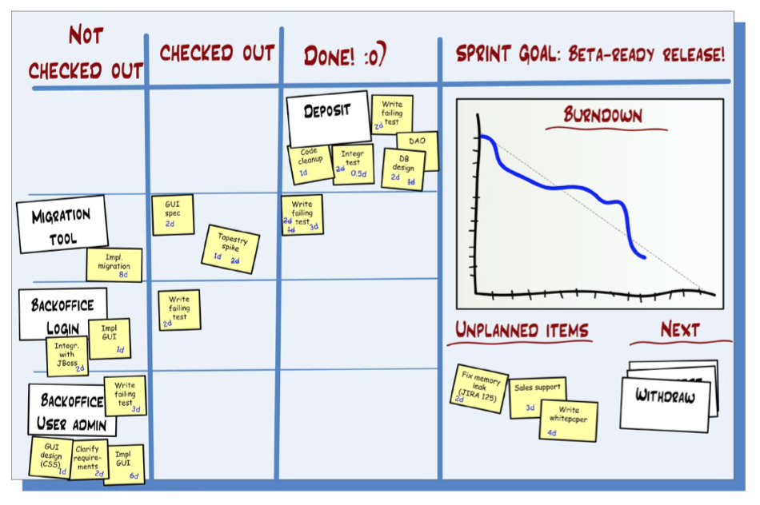
The Sprint Backlog + The Burndown Chart (aka, the Scrum Board)
Notes:
Here is the sprint part-way through. They’re on track!
Image borrowed from “Scrum and XP from the Trenches”.

Slide 17
One Popular Agile Framework: Scrum
Notes:
https://www.softwaysolutions.com/blog/wp-content/uploads/2012/10/scrum_process_big3.jpg

Slide 18
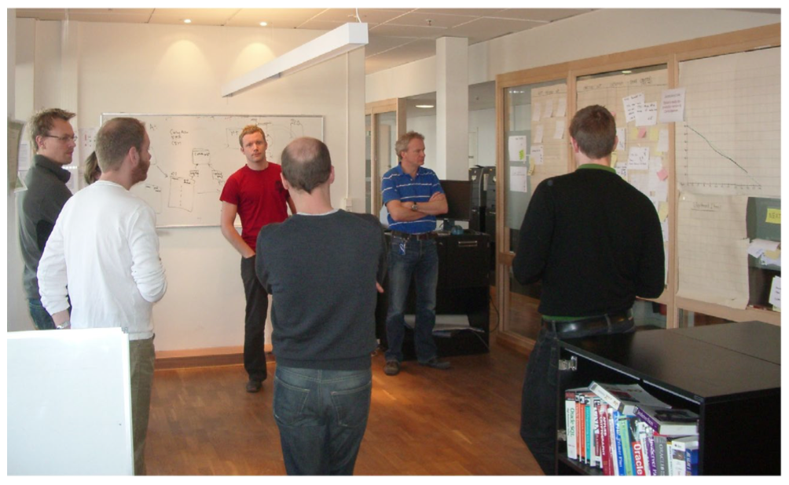
The daily scrum: A brief stand-up meeting where you state your progress to the team.
Answer:
“What did I do yesterday that helped our team meet the sprint goal?”
“What will I do today to help our team meet the sprint goal?”
“Do I see any impediments that prevent me or our team from meeting the sprint goal?”
Notes:
Notice they are all standing up, and they are gathered around the scrum board.
This text and photo are borrowed from “Scrum and XP from the Trenches”.

Slide 19
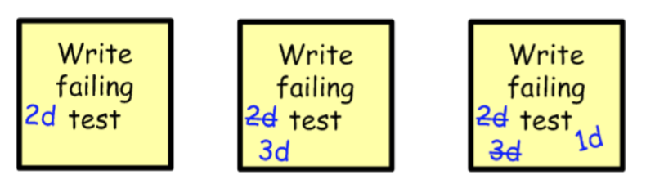
Update the team on your progress! (or lack thereof)
Notes:
This photo is borrowed from “Scrum and XP from the Trenches”.

Slide 20
One Popular Agile Framework: Scrum
Notes:
https://www.softwaysolutions.com/blog/wp-content/uploads/2012/10/scrum_process_big3.jpg

Slide 21

Sprint review: I.e. The demo!
Why?
Other people learn what your team is doing.
The demo attracts vital feedback from stakeholders.
Demos are (or should be) social events where teams interact.
Doing a demo forces the team to actually finish stuff and release it (even if it is only to a test environment). “Without demos, we kept getting huge piles of 99%-finished stuff.”
Notes:
This text is borrowed from “Scrum and XP from the Trenches”.

Slide 22
One Popular Agile Framework: Scrum
Notes:
https://www.softwaysolutions.com/blog/wp-content/uploads/2012/10/scrum_process_big3.jpg

Slide 23
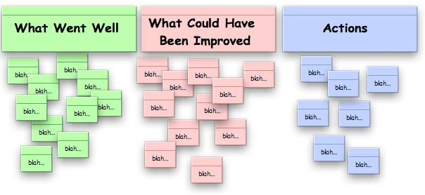
The Sprint Retrospective
“Without retrospectives you will find that the team keeps making the same mistakes over and over again.”
Notes:
This text is borrowed from “Scrum and XP from the Trenches”.

Slide 24
The parts of scrum we’ll simulate in your capstone project:
The sprint planning meeting:
You create the product backlog (i.e. a comprehensive list of stories for your project -- dream big here!).
An instructor plays the role of ‘product owner’ and prioritizes your product backlog.
You + one other student + an instructor play planning poker to create your sprint backlog. Along the way you create several tasks for each story in your sprint backlog.
Notes:
See Ryan’s example product backlog for inspiration.
Your homework this weekend is to create stories for your product backlog. Write each story on an index card. (We’ll provide you with index cards.)

Slide 25
The parts of scrum we’ll simulate in your capstone project:
The scrum board:
You get a 2’x2’ slice of white board.
Create three columns: ‘not checked out’, ‘checked out’, and ‘done’.
Put your stories and tasks in the ‘not checked out’ column.
Draw an empty burndown chart spanning 2.5 weeks.
Begin working!

Slide 26
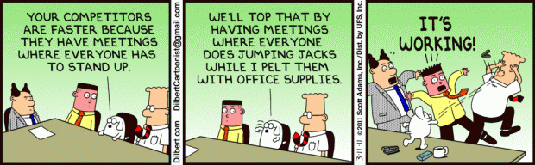
The parts of scrum we’ll simulate in your capstone project:
The daily scrum standup meetings:
You will be assigned to a scrum group of 3-5 students + 1 instructor.
You will hold scrum standup meetings every morning at 9:30am with your scrum group.
You will update your scrum board and inform your scrum group of your progress yesterday + your plan for today + any obstacles you foresee.
You will not drone on and on and on.

Slide 27

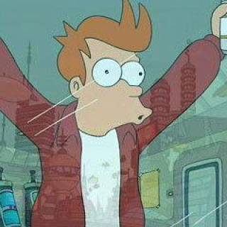
The parts of scrum we’ll simulate in your capstone project:
The sprint review (i.e. the demo):
This is Hiring Day, basically. :)
The sprint retrospective:
Will be held Monday of the final week (i.e. Monday the week following Hiring Day).

Slide 28
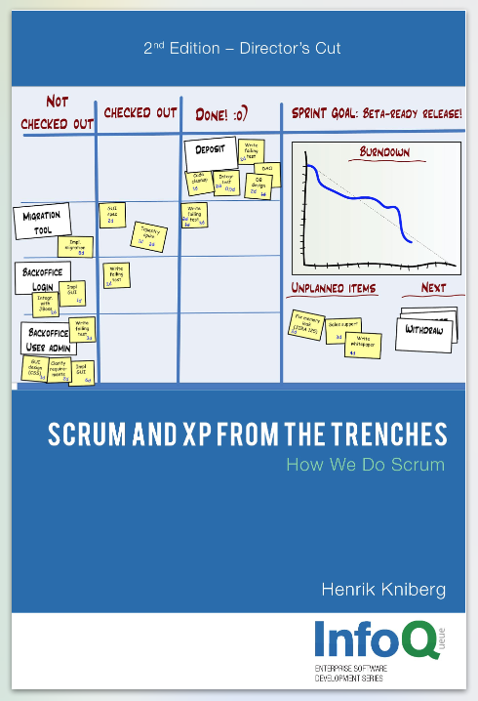
Credit
Many of the photos and text in this deck are from:
Scrum and XP from the Trenches by Henrik Kniberg
Btw: the PDF version is free; a hard copy is $25. (It’s a great read if you plan to work in a Scrum dev shop.)
Notes:
https://www.infoq.com/minibooks/scrum-xp-from-the-trenches-2

